Slide 1


FAILURE ANALYSIS OF SLEWING GEAR BOX AND BELT DRIVE DRUM ASSEMBLY OF SPREADER 116 AT NLCIL Submitted by LEELAVATHI S 1812047 NIHIL MATHEW A 1812062 SANJAI RAMASAMY K 1812082 THALAPATHY S 1812105 Supervised by Dr. J. SELWIN RAJADURAI, M.E, Ph.D., MECHANICAL DEPT, ACGCET, KARAIKUDI. & Mr. J VENKATESAN, ACM/MECH/SME/MINE IA, NLC INDIA LTD, NEYVELI.
ALAGAPPA CHETTIAR GOVERNMENT COLLEGE OF ENGINEERING AND TECHNOLOGY, KARAIKUDI 630003.
(An Autonomous Institution; Affiliated to Anna University, Chennai -600 025)

Slide 2
ABSTRACT
Neyveli Lignite Corporation India Limited (NLCIL) is a leading public sector undertaking owned by a government of India.
In NLCIL mines, open cast mining technology is adopted in which numbers of specialized mining equipment’s (SME) are used. Spreader plays a vital role in mining.
Upon analysis a major problem has been raised from Spreader’s slewing gear box, then the common failure is produced by the belt drive drum assembly’s shaft due to shearing.
Here all failures occurring in slewing gear box and belt drive drum assembly is studied and analyzed based on FMEA & FEA analysis.

Slide 3
INTRODUCTION
NLC India Ltd (NLCIL) formerly, Neyveli Lignite Corporation Limited, a Navaratna enterprise of Government of India (GOI).
It is a public-sector enterprise engaged in mining of lignite and generation of power through lignite based thermal power plants.
The Neyveli Mine IA lignite mine is an opencast mine, operated by Neyveli Lignite Corporation (NLC) India Limited, with a capacity of 3 million tons per year, and located near the town of Neyveli in Cuddalore district in Tamil Nadu, India.
The mine IA has proposed expansion to 4 million tons per annum.
The mine supplies the 600-megawatt (MW) Neyveli Thermal Power Station and the 420MW Thermal Power Station I Expansion.

Slide 4
SME - SPREADER
Spreaders (specialized mining equipment) used in surface mining and mechanical engineering/civil engineering.
The primary function of a spreader is to act as a continuous spreading machine in large-scale open pit mining operations.
Bucket-wheel excavators, BWEs, are used for continuous overburden removal in surface mining applications.
The overburden is then delivered to the discharge boom, which transfers the cut earth to another machine for transfer it to the central collection area where the material will be sorted. Then the remains of the overburden will be transported to the spreader which then scatters the overburden at the dumping ground.

Slide 5
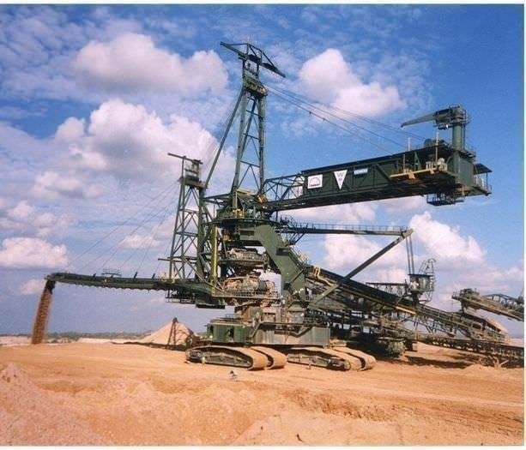
VIEW OF SPREDER

Slide 6
OBJECTIVES
Our project mainly entangles two objectives.
To perform a failure analysis in a particular shaft. This shaft is the main component, used for rotating the drum of conveyor belt in the spreader. It has been recorded that the shaft is failing for every 1-2 month. Varying impact load on belt is bringing failure to shaft.
To prevent the failure of slewing gearbox due to loosening of bolts which results in oil leakage.

Slide 7
WORKING METHODOLOGY
Study of assembly and parts
Working and function of belt drive drum assembly & slewing gearbox
Determine action to reduce risk
Identified failure modes
Determination of RPN number
Observed effects of the failure mode
Occurrence and current control methods
Determine of severity of failure modes
Identify the causes

Slide 8
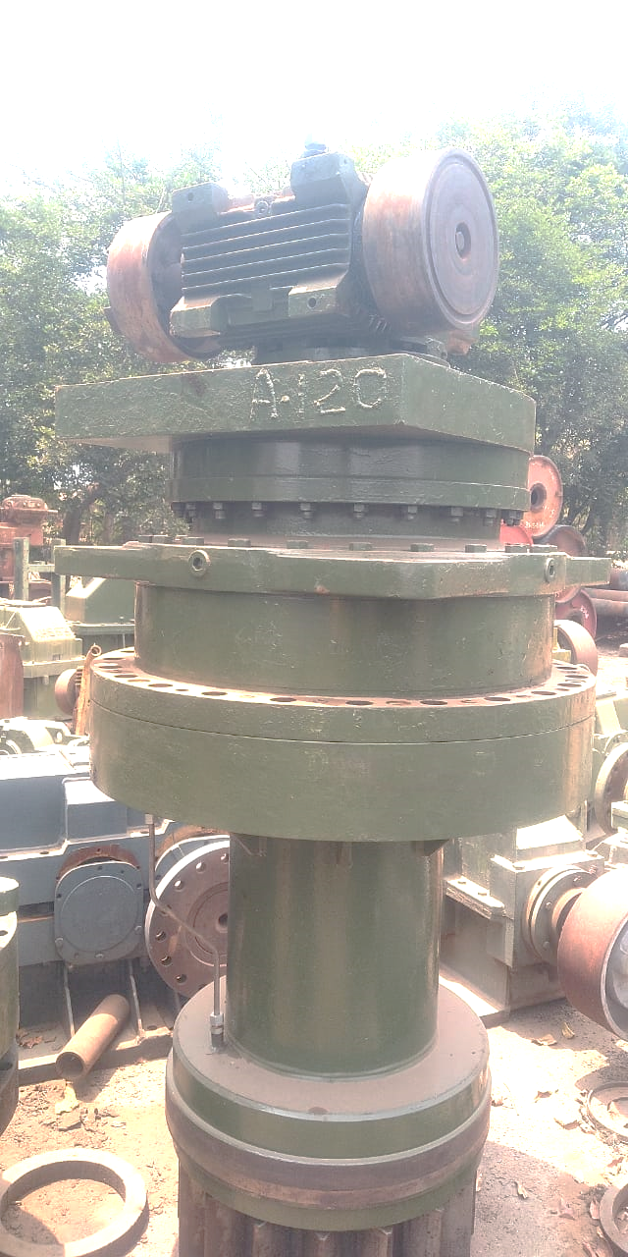
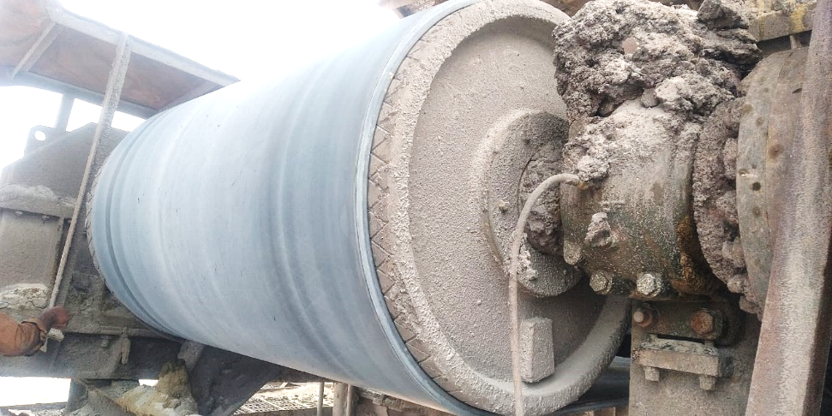
PARTS ANALYSED
SLEWING GEAR BOX
BELT DRIVE DRUM ASSEMBLY

Slide 9
WORKING OF BELT DRIVE DRUM ASSEMBLY
The belt drum assembly is used to move the conveyor belt in the spreader.
There are two types of drum in spreader.
A) Driver
B) Driven
From the belt drive gearbox the power is transmitted to the drum by shaft. The rotating drum results in the linear motion of the conveyor belt which help the sand to fill the area.

Slide 10
WORKING OF SLEWING GEAR BOX
Slewing gearbox is used to slew the discharge boom of the spreader.
It rotates up to 180 degrees.
The slew gearbox having sun pinion and planetary gears arrangement to reduce the initial input speed.
The slew gearbox is powered by using electrical motor.

Slide 11
FAILURE DATA
SI. NO | DATE | UNIT NO | FAILRE DATA OF BELT DRIVE DRUM ASSEMBLY
1. | 13-11-2017 | A/232 | Shaft got cut near coupling.
2. | 24-11-2017 | A/552 | Shaft got cut in-between shaft taper Step bearing assembly.
3. | 02-12-2017 | A/552 | Shaft got cut at bearing seating.
4. | 14-08-2018 | A/552 | Shaft got cut near coupling.
5. | 15-09-2018 | A/552 | Shaft got cut near coupling.
6. | 19-03-2019 | A/200 | Shaft got cut in-between shaft taper Step bearing assembly.
7. | 07-11-2019 | A/650 | Shaft got cut in-between shaft taper Step bearing assembly.
8. | 16-11-2019 | A/650 | Shaft got cut near coupling.
9. | 27-01-2020 | A/271 | Shaft got cut in-between shaft taper Step bearing assembly.
10. | 11-04-2020 | A/271 | Shaft got cut near coupling.
SI.NO | DATE | UNIT NO | FAILURE DATA OF SLEWING GEAR BOX
1. | 11-05-2020 | U/485 | Bolts got loosen results in oil leak
2. | 21-10-2019 | U/485 | Bolts got loosen results in oil leak
3. | 12-10-2019 | A/200 | Bolts got loosen results in oil leak
4. | 08-10-2019 | A/200 | Bolts got loosen results in oil leak
5. | 28-05-2019 | A/135 | Bolts got loosen results in oil leak
6. | 19-03-2019 | A/200 | Bolts got loosen results in oil leak
7. | 25-02-2019 | A/200 | Bolts got loosen results in oil leak
8. | 24-02-2019 | A/200 | Bolts got loosen results in oil leak
9. | 24-02-2019 | A/140 | Bolts got loosen results in oil leak
10. | 14-02-2019 | A/140 | Bolts got loosen results in oil leak

Slide 12
PROBLEM IDENTIFICATION
MAJOR CAUSES FOR FAILURE IN BELT DRIVE DRUM ASSEMBLY:
Shaft got cut near coupling.
Shaft got cut in-between shaft taper step bearing assembly.
Shaft got cut at bearing seating.
MAJOR CAUSES FOR FAILURE IN SLEWING GEAR BOX:
The torque is transmitted to the bolts which causes shear.
The shear results in loosening of bolts, which causes opening of bolts resulting in oil leak.

Slide 13
RISK PRIORITY NUMBER
RPN FOR SHAFT:
The Risk Priority Number, or RPN, is a numeric assessment of risk assigned to a process, or steps in a process, as part of Failure Modes and Effects Analysis (FMEA)
RPN number of the shaft = S x O x D
= 7 x 7 x 7
= 343
RPN FOR SLEWING GEAR BOX HOUSING:
RPN number of the oil leakage due to bolts = S x O x D
= 6 x 7 x 7
= 294

Slide 14
SUGGESTIONS FOR BELT DRIVE DRUM ASSEMBLY
The bearing withstands the load and no bearing failure reported and the dynamic load of bearing found matching.
Shaft re modification work with the given load was undertaken.
Shaft size for existing mode is found to be 180 mm.
Taking into consideration the shaft failure increase in the factor of safety was suggested.
When the factor of safety increased the shaft size got increased to 200 mm.
Without changing the 260 diameter step increase the diameter of 180mm diameter to 200 mm diameter.

Slide 15
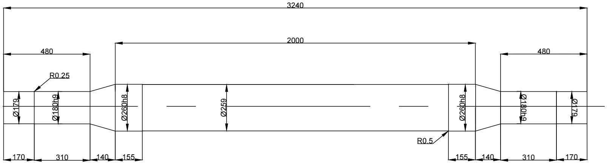
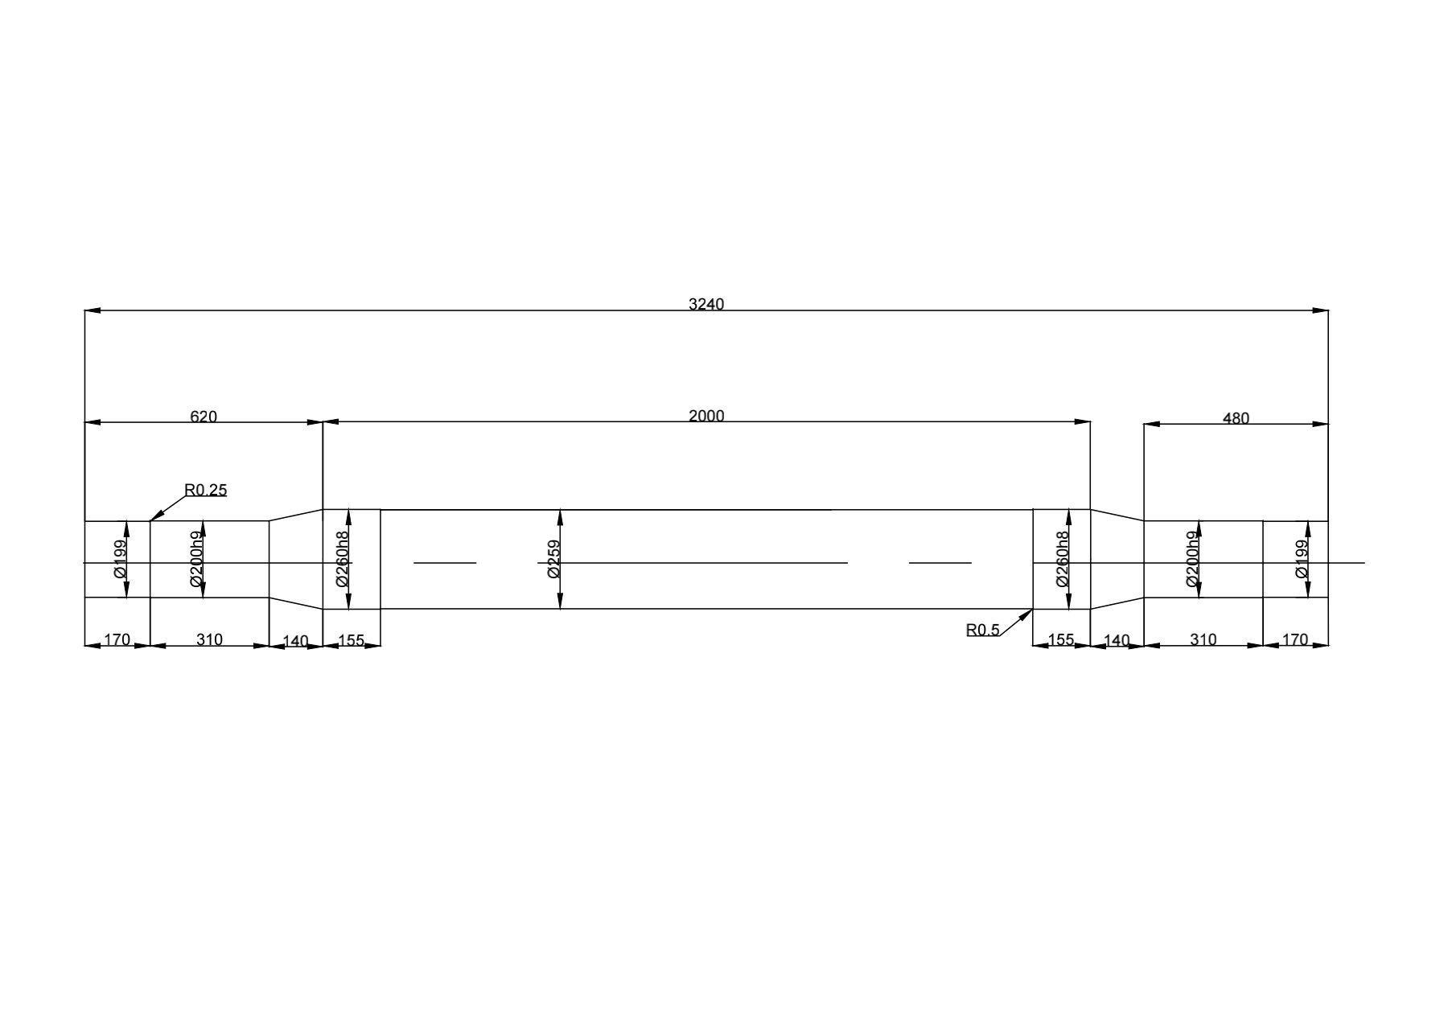
EXISTING SHAFT
MODIFIED SHAFT

Slide 16
SELECTION OF BEARING
The bearing used in the belt drive drum assembly of spreader is spherical roller bearing.
For shaft of existing model the bearing used is 23140 CCK/W33 and bearing sleeve is found to be H3140.
As per the SKF/FAG bearing catalogue the bearing number found to be 23144 CCK/W33 of shaft 200 mm.
Bearing sleeve found to be H3148.

Slide 17
SOFTWARES USED
FOR MODELING:
SOLIDWORKS 2020
CATIA V5 2018
FOR ANALYSIS:
ANSYS 2018 R1
ANALYSIS PERFORMED
Stress analysis
Deformation analysis
Modal analysis

Slide 18
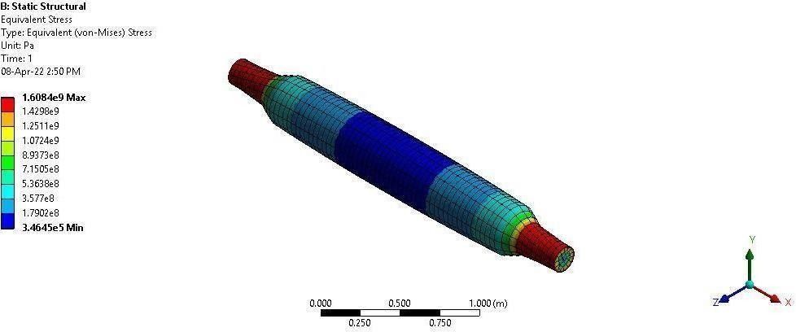
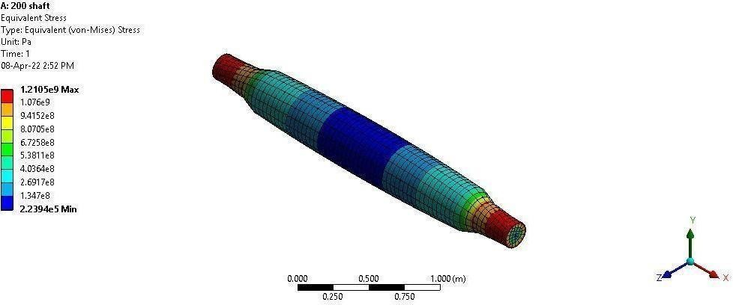
STRESS IN EXISTING MODEL OF SHAFT
STRESS IN MODIFIED MODEL OF SHAFT

Slide 19
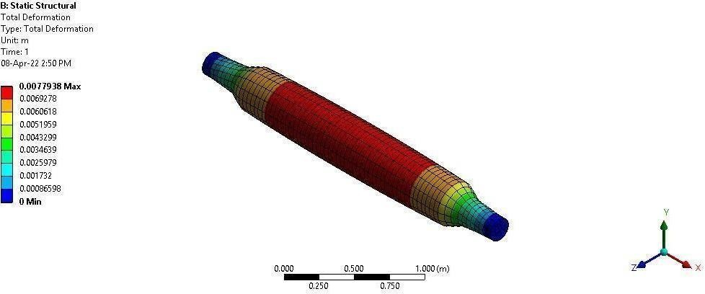
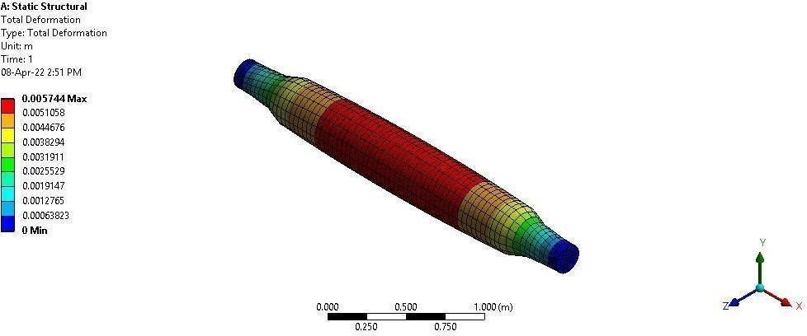
DEFORMATION IN EXISTING MODEL
DEFORMATION IN MODIFIED MODEL

Slide 20
SUGGESTIONS FOR SLEWING GEAR BOX
Torque arresting/transmitting ring plates (2 nos) with key be introduced to the in between mounting mother plate and the gearbox fixing joint.
The joint between ring plates (900 mm diameter) and its preceding joint to be drilled for additional fixing holes and dowel holes.
Additional fixing holes 6 nos × M20 size
Additional dowel holes 6 nos - ∅20 & dowel pins

Slide 21
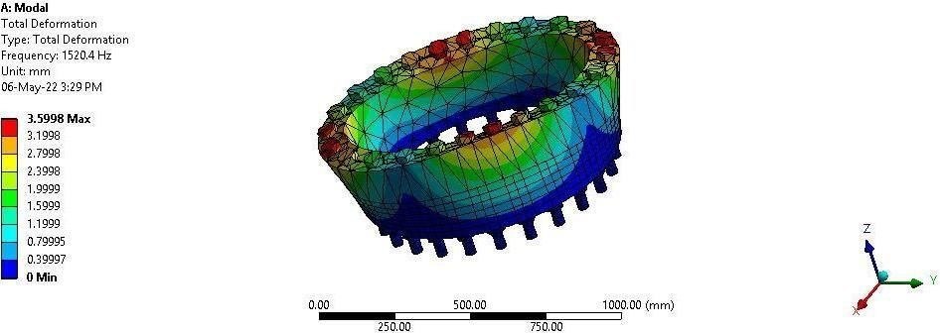
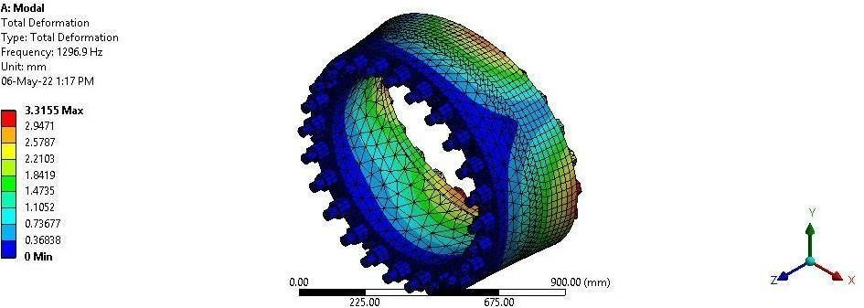
MODAL ANALYSIS OF EXISTING MODEL
MODAL ANALYSIS OF MODIFIED MODEL

Slide 22
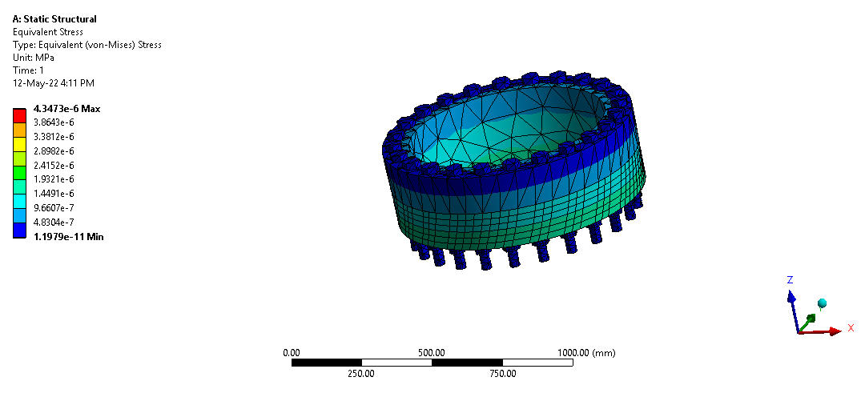
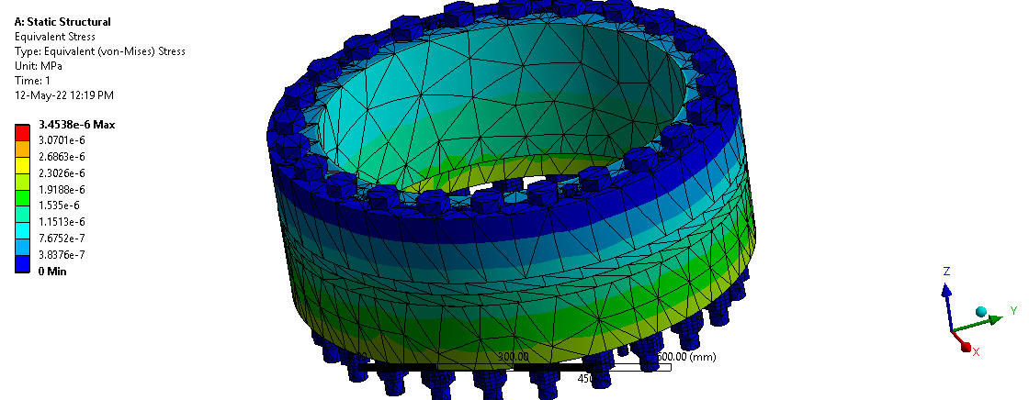
STRESS IN EXISTING MODEL
STRESS IN MODIFIED MODEL

Slide 23
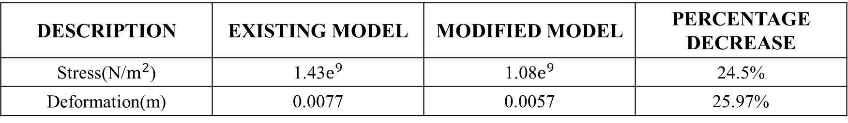
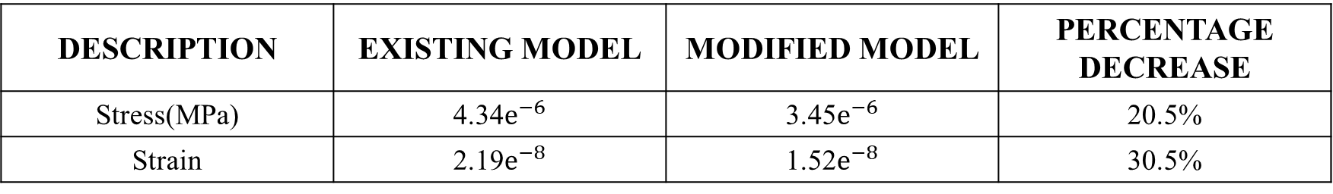
FEA RESULTS
FEA RESULTS FOR SHAFT:
DESCRIPTION | EXISTING MODEL | MODIFIED MODEL | PERCENTAGE DECREASE
Stress(N/$m^{2}$) | 1.43$e^{9}$ | 1.08$e^{9}$ | 24.5%
Deformation(m) | 0.0077 | 0.0057 | 25.97%
FEA RESULTS FOR SLEWING GEAR BOX HOUSING:
DESCRIPTION | EXISTING MODEL | MODIFIED MODEL | PERCENTAGE DECREASE
Stress(MPa) | 4.34$e^{−6}$ | 3.45$e^{−6}$ | 20.5%
Strain | 2.19$e^{−8}$ | 1.52$e^{−8}$ | 30.5%
The operating frequency is found to be 16 Hz which is very much smaller than the modified frequency which has a frequency of 1296 Hz

Slide 24
COST ANALYSIS
Existing shaft and modified shaft manufacturing cost expected to be remains same or with marginal difference is obtained from NLCIL executives. THE BEARING COST FOR 23140 CCK/W33 = 38940 Rs THE BEARING COST FOR 23144 CCK/W33 = 52815.17 Rs The new Plummer block cost is same as the previous Plummer block (data given by department). Output coupling manufacturing cost may remain the same/or with marginal increase by considering the increase in bearing and Plummer block purchase value the cost involved is RS 13875.17/-

Slide 25
CONCLUSION
The shaft cut was a major cause for the failure of belt drum assembly. The diameter of the shaft at both ends has been increased from 180mm to 200mm.
From the FEA analysis, it is found that the internal stress in the suggested model is 25% less than in the existing model.
The failure of the slewing gearbox was oil leakage due to shearing of the bolts. To overcome this problem, the torque arresting/transmitting ring plates (2 no’s) with keys are introduced.
The joint between ring plates for the diameter of 900mm and its preceding joint had to be drilled for additional fixing bolts M20 and Additional dowel pins diameter 20mm.
From that, the loosening of bolts due to shear will get arrested. Hence, there is no leakage of oil into the slewing gearbox of the spreader.

Slide 26
REFERENCES
1. Lough, K. G., Stone, R. and Tumer, I. Y. (2009), “The risk in early design method”, Journal of Engineering Design,Volume 20, Issue 2,pp. 155 – 173.
2. S. Kahrobaee (2011), “Risk-based Failure Mode and Effect Analysis for wind turbines (RB-FMEA)”IEEE Explore, pp. 1-7.
3. F. Mozaffari (2013), “Implementation of FMEA to improve the reliability of GEO satellite payload” IEEE Explore, pp. 1-6.
4. M. Molhanec (2012), “Model based FMEA - An efficient tool for quality management of the free lead soldering” IEEE Explore,pp.230-236.
5. http://www.Wikipedia.Com
6. Theory of Mechanics -R.S. KHURMI.
7. SMES Maintenance Manual.
8. SMES Operating Instruction Manual.
9. SKF bearing catalogue.

Slide 27
THANK YOU.s

